Slide 1

CodeVR 1.0
Team Members: Rolf Gilet, Andres Chalela, Miguel Jardines Product Owner:Francisco Ortega
Instructor: Masoud Sadjadi School of Computing and Information Sciences Florida International University
Final Presentation
Spring 2018
Notes:
7 seconds.( I will select 2 best slides (i will give them extra points and students will present for CIS committee)
Greet your audience, thank them for attending your presentation, introduce yourself, introduce your project, introduce your team members, and quickly indicate what each of you did in a high-level manner, and put more emphasis on your part/contribution.

Slide 2
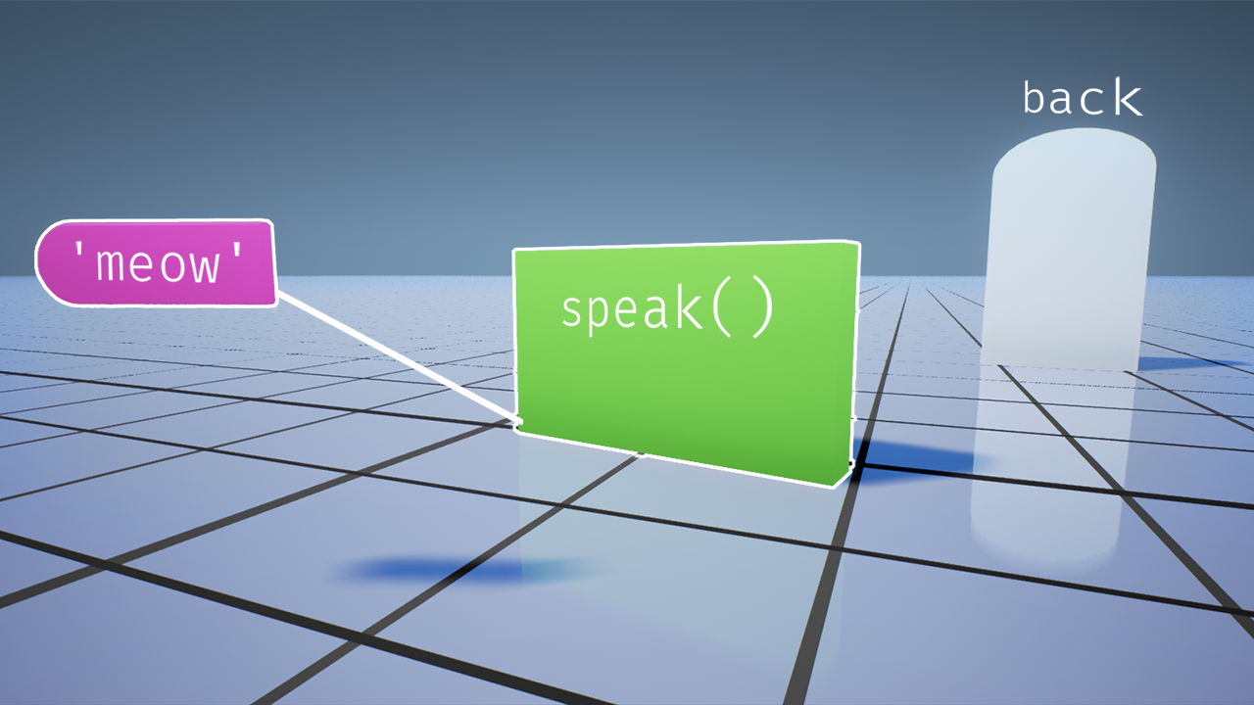
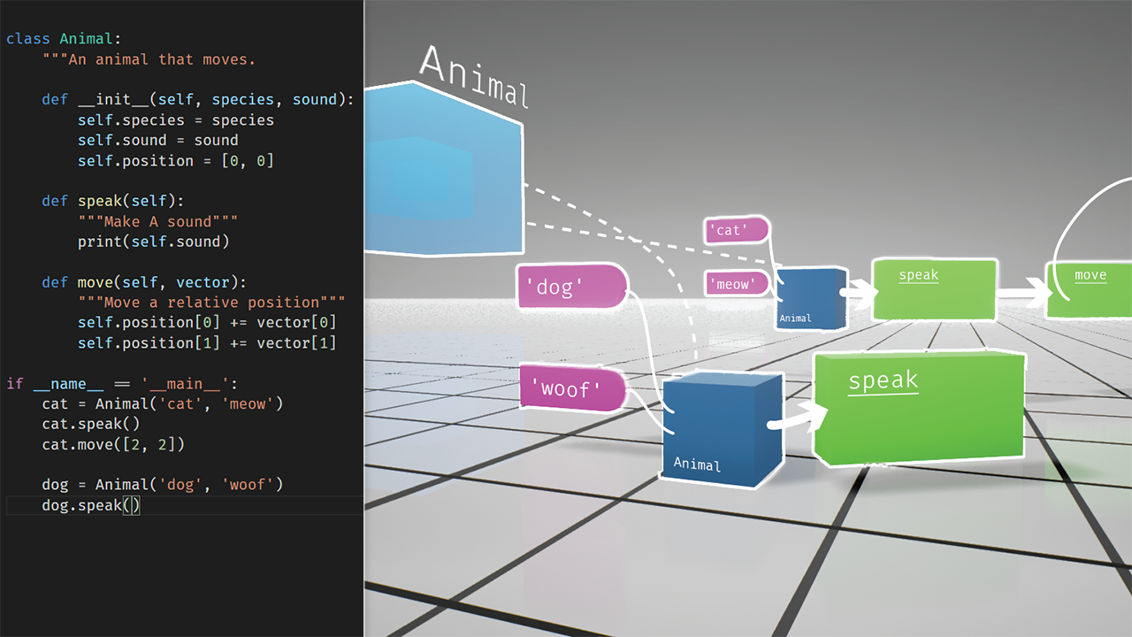
Project definition
Code VR 1.0
Notes:
10 seconds.
Introduce the problem that the whole project (in all versions) tackles with GIF or screenshot.

Slide 3
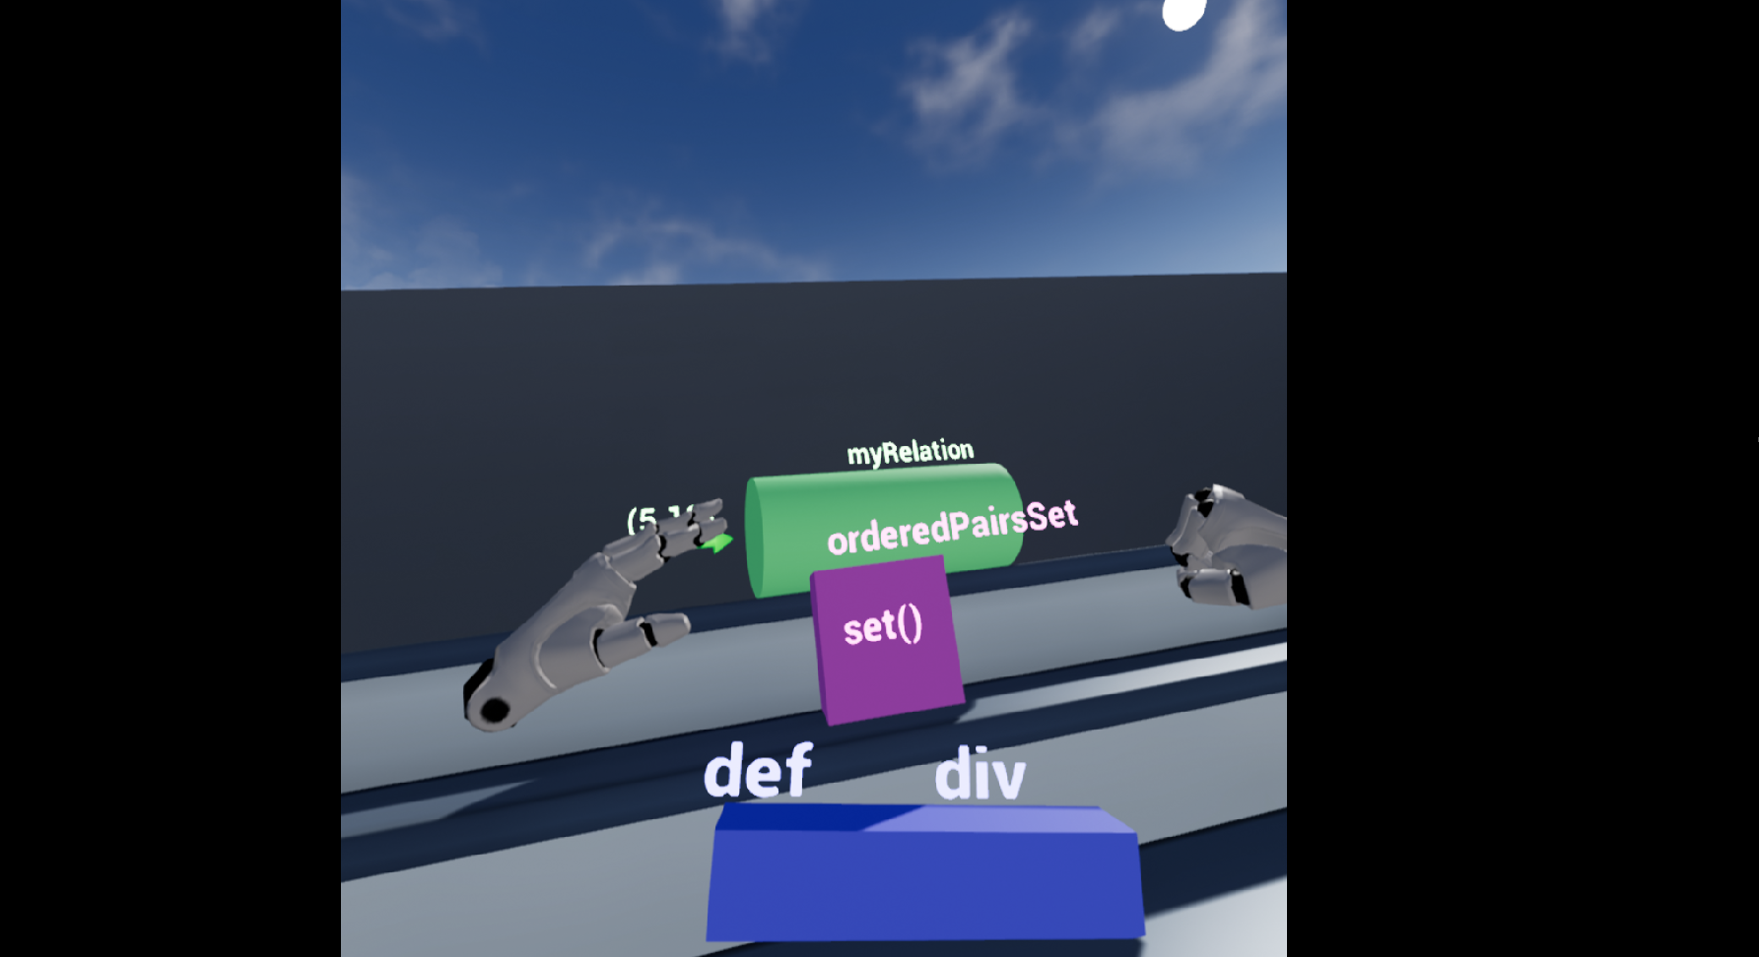
Project definition
Notes:
20 seconds.
Introduce the problem that the your project (in new version) tackles with GIF or screenshot.

Slide 4
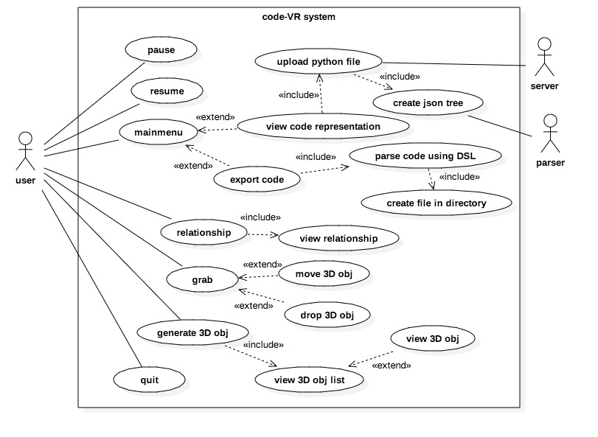
Requirements: Use Cases
Notes:
5 seconds
Show the Use Case Diagram for the whole project. Highlight your use cases.

Slide 5
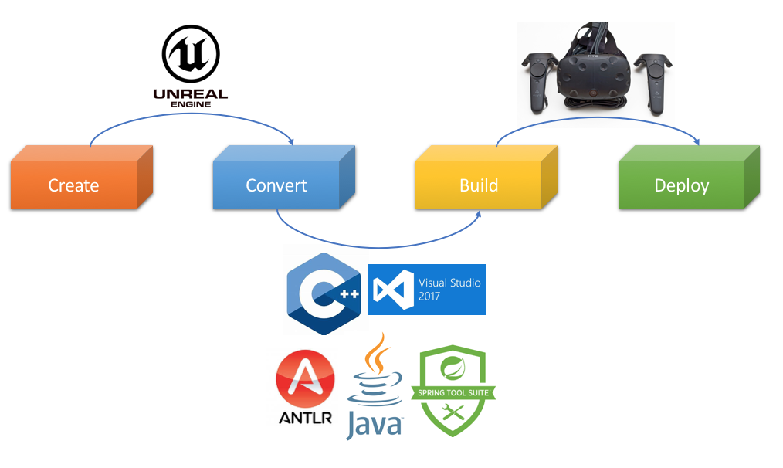
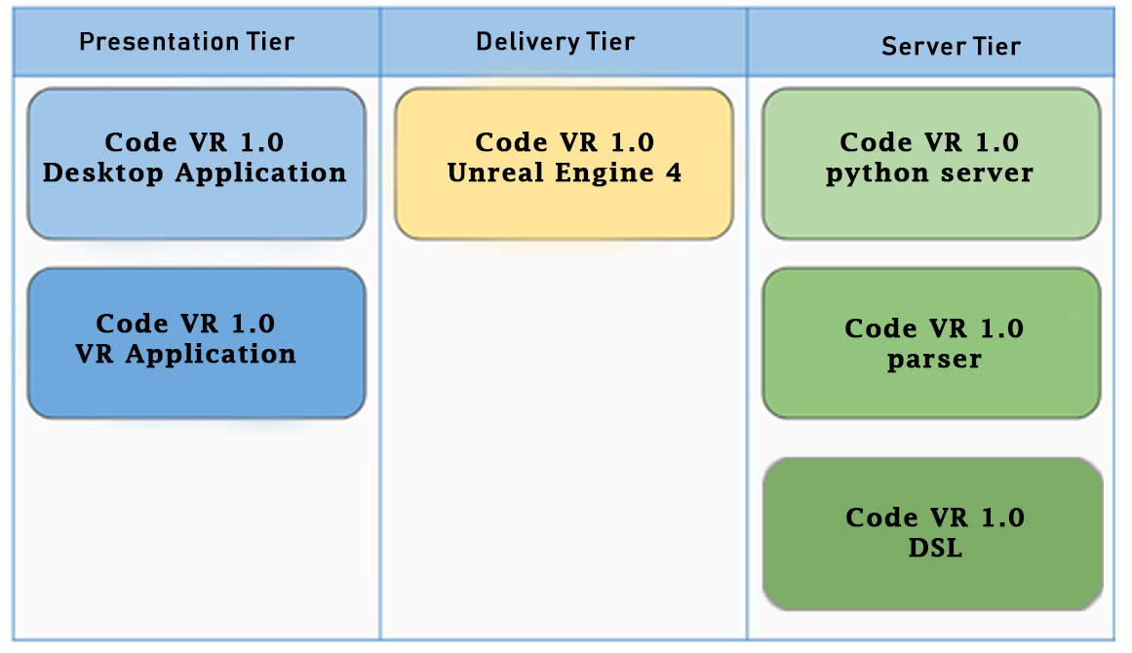
System Design: Architecture
Notes:
20 seconds
System design: Highlight the parts that you contributed to them.
1. System decomposition; identify the architecture patterns used
2. System deployment – h/w and s/w requirements

Slide 6
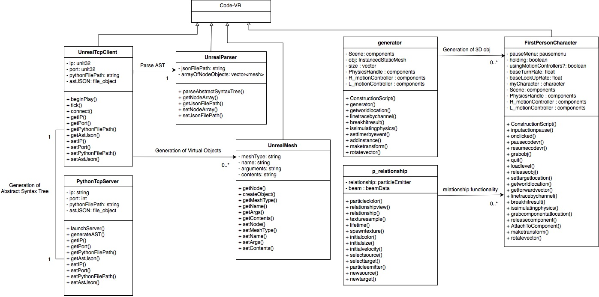
Minimal Class Diagram
Notes:
10 seconds.Minimal class diagram. Highlight the classes that you created/modified
Identify the design patterns used (one or more slides).

Slide 7
User Stories
1. User Story ID #666 Embedded Python Server Execution
2. User Story ID #691 3D shape generator functionality
3. User Story ID #694 Update code-VR Menu
4. User Story ID #688 Grab and Drop Functionality
5. User Story ID #692 Relationship Functionality
Notes:
5 seconds.
List the user stories that you worked on them.(put in order of importance). Stay focused on the parts that you have been working.

Slide 8
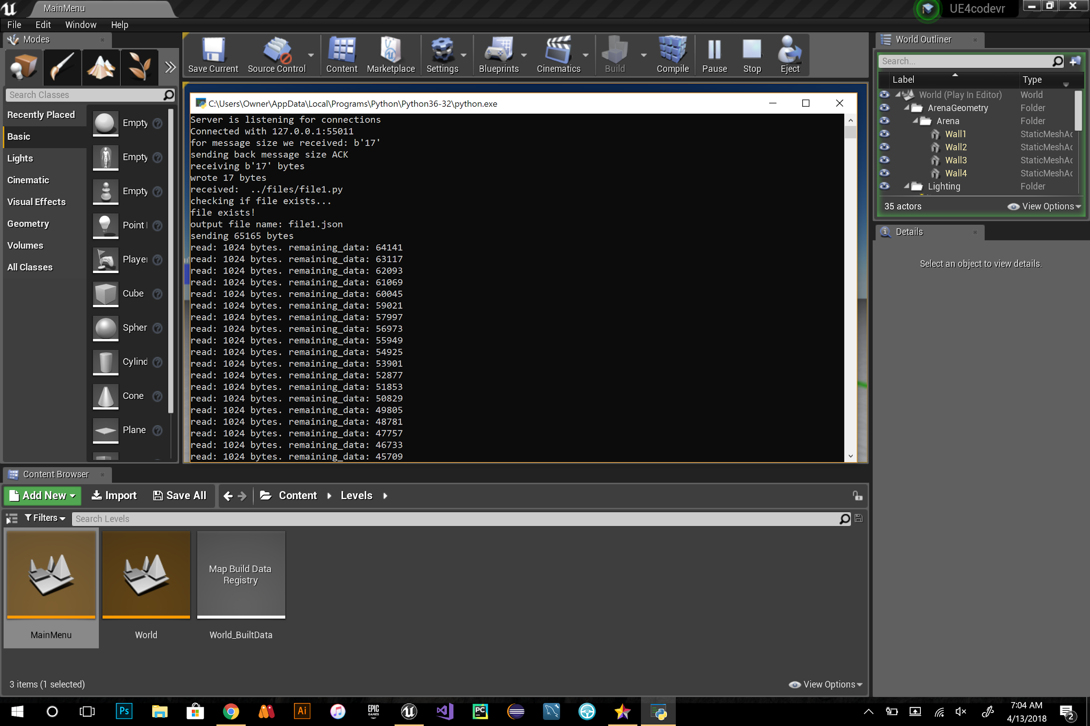
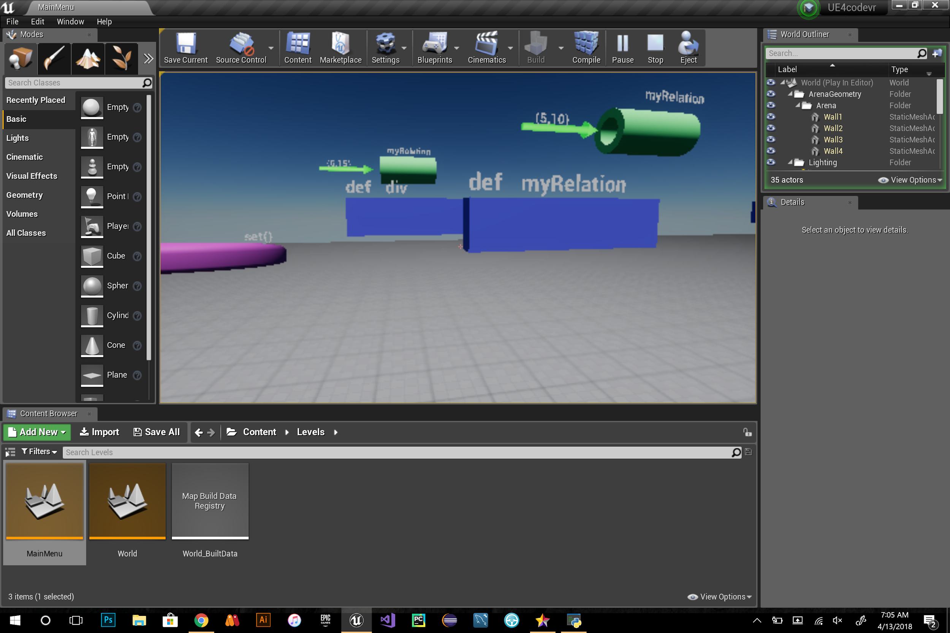
User Story #666 Embedded Python Server Execution
Notes:
60 seconds
The tile of user story
The most important user story you worked on it. You have to describe this one very well and be proud of that.
Please present and show the complexity of your work, code, algorithms, and technical challenges and technologies you have used. (you could use screenshot if you want. Visual presentations are better than text presentation)
Go into the details of the most important/significant tasks using bullet lists or visual graphs or state chart diagram
Sequence Diagram for this user story is mandatory (in another separate page if required)
Demo using screenshots or GIF (in another separate page if required)

Slide 9
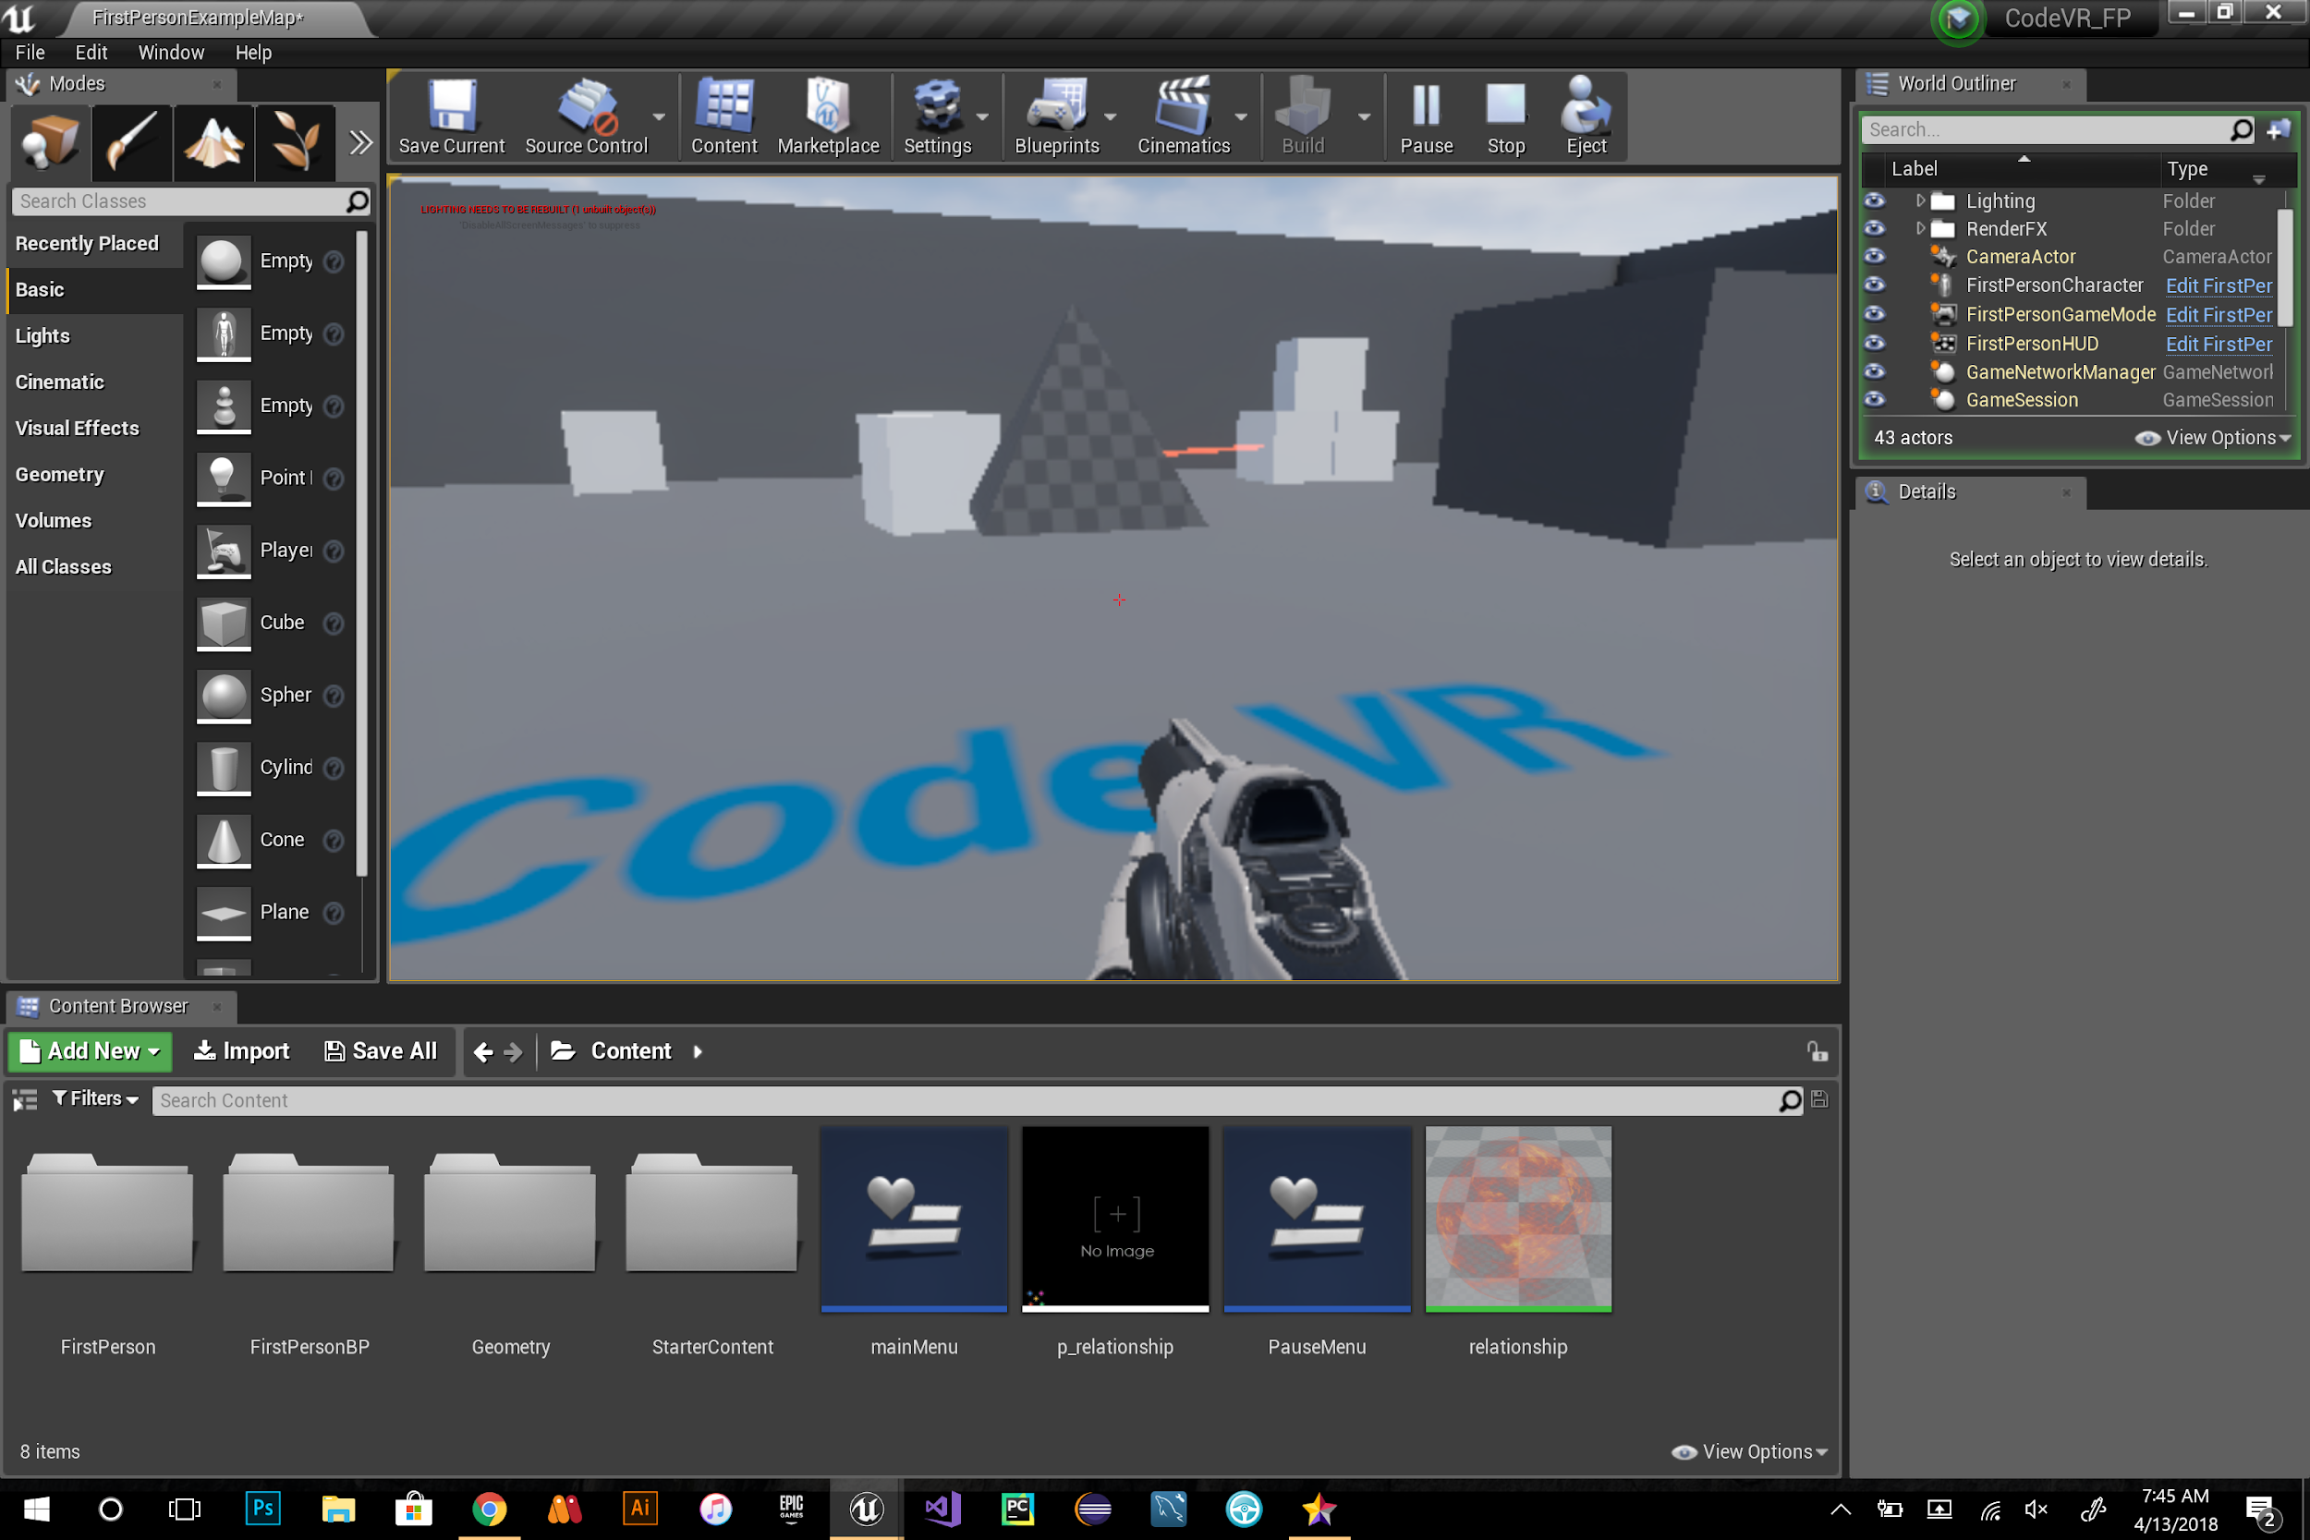
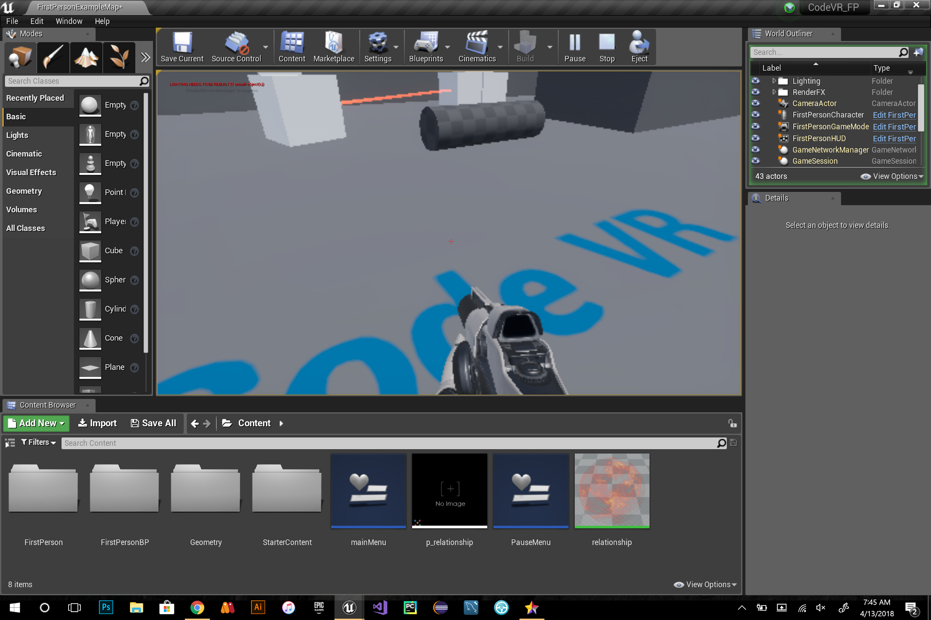
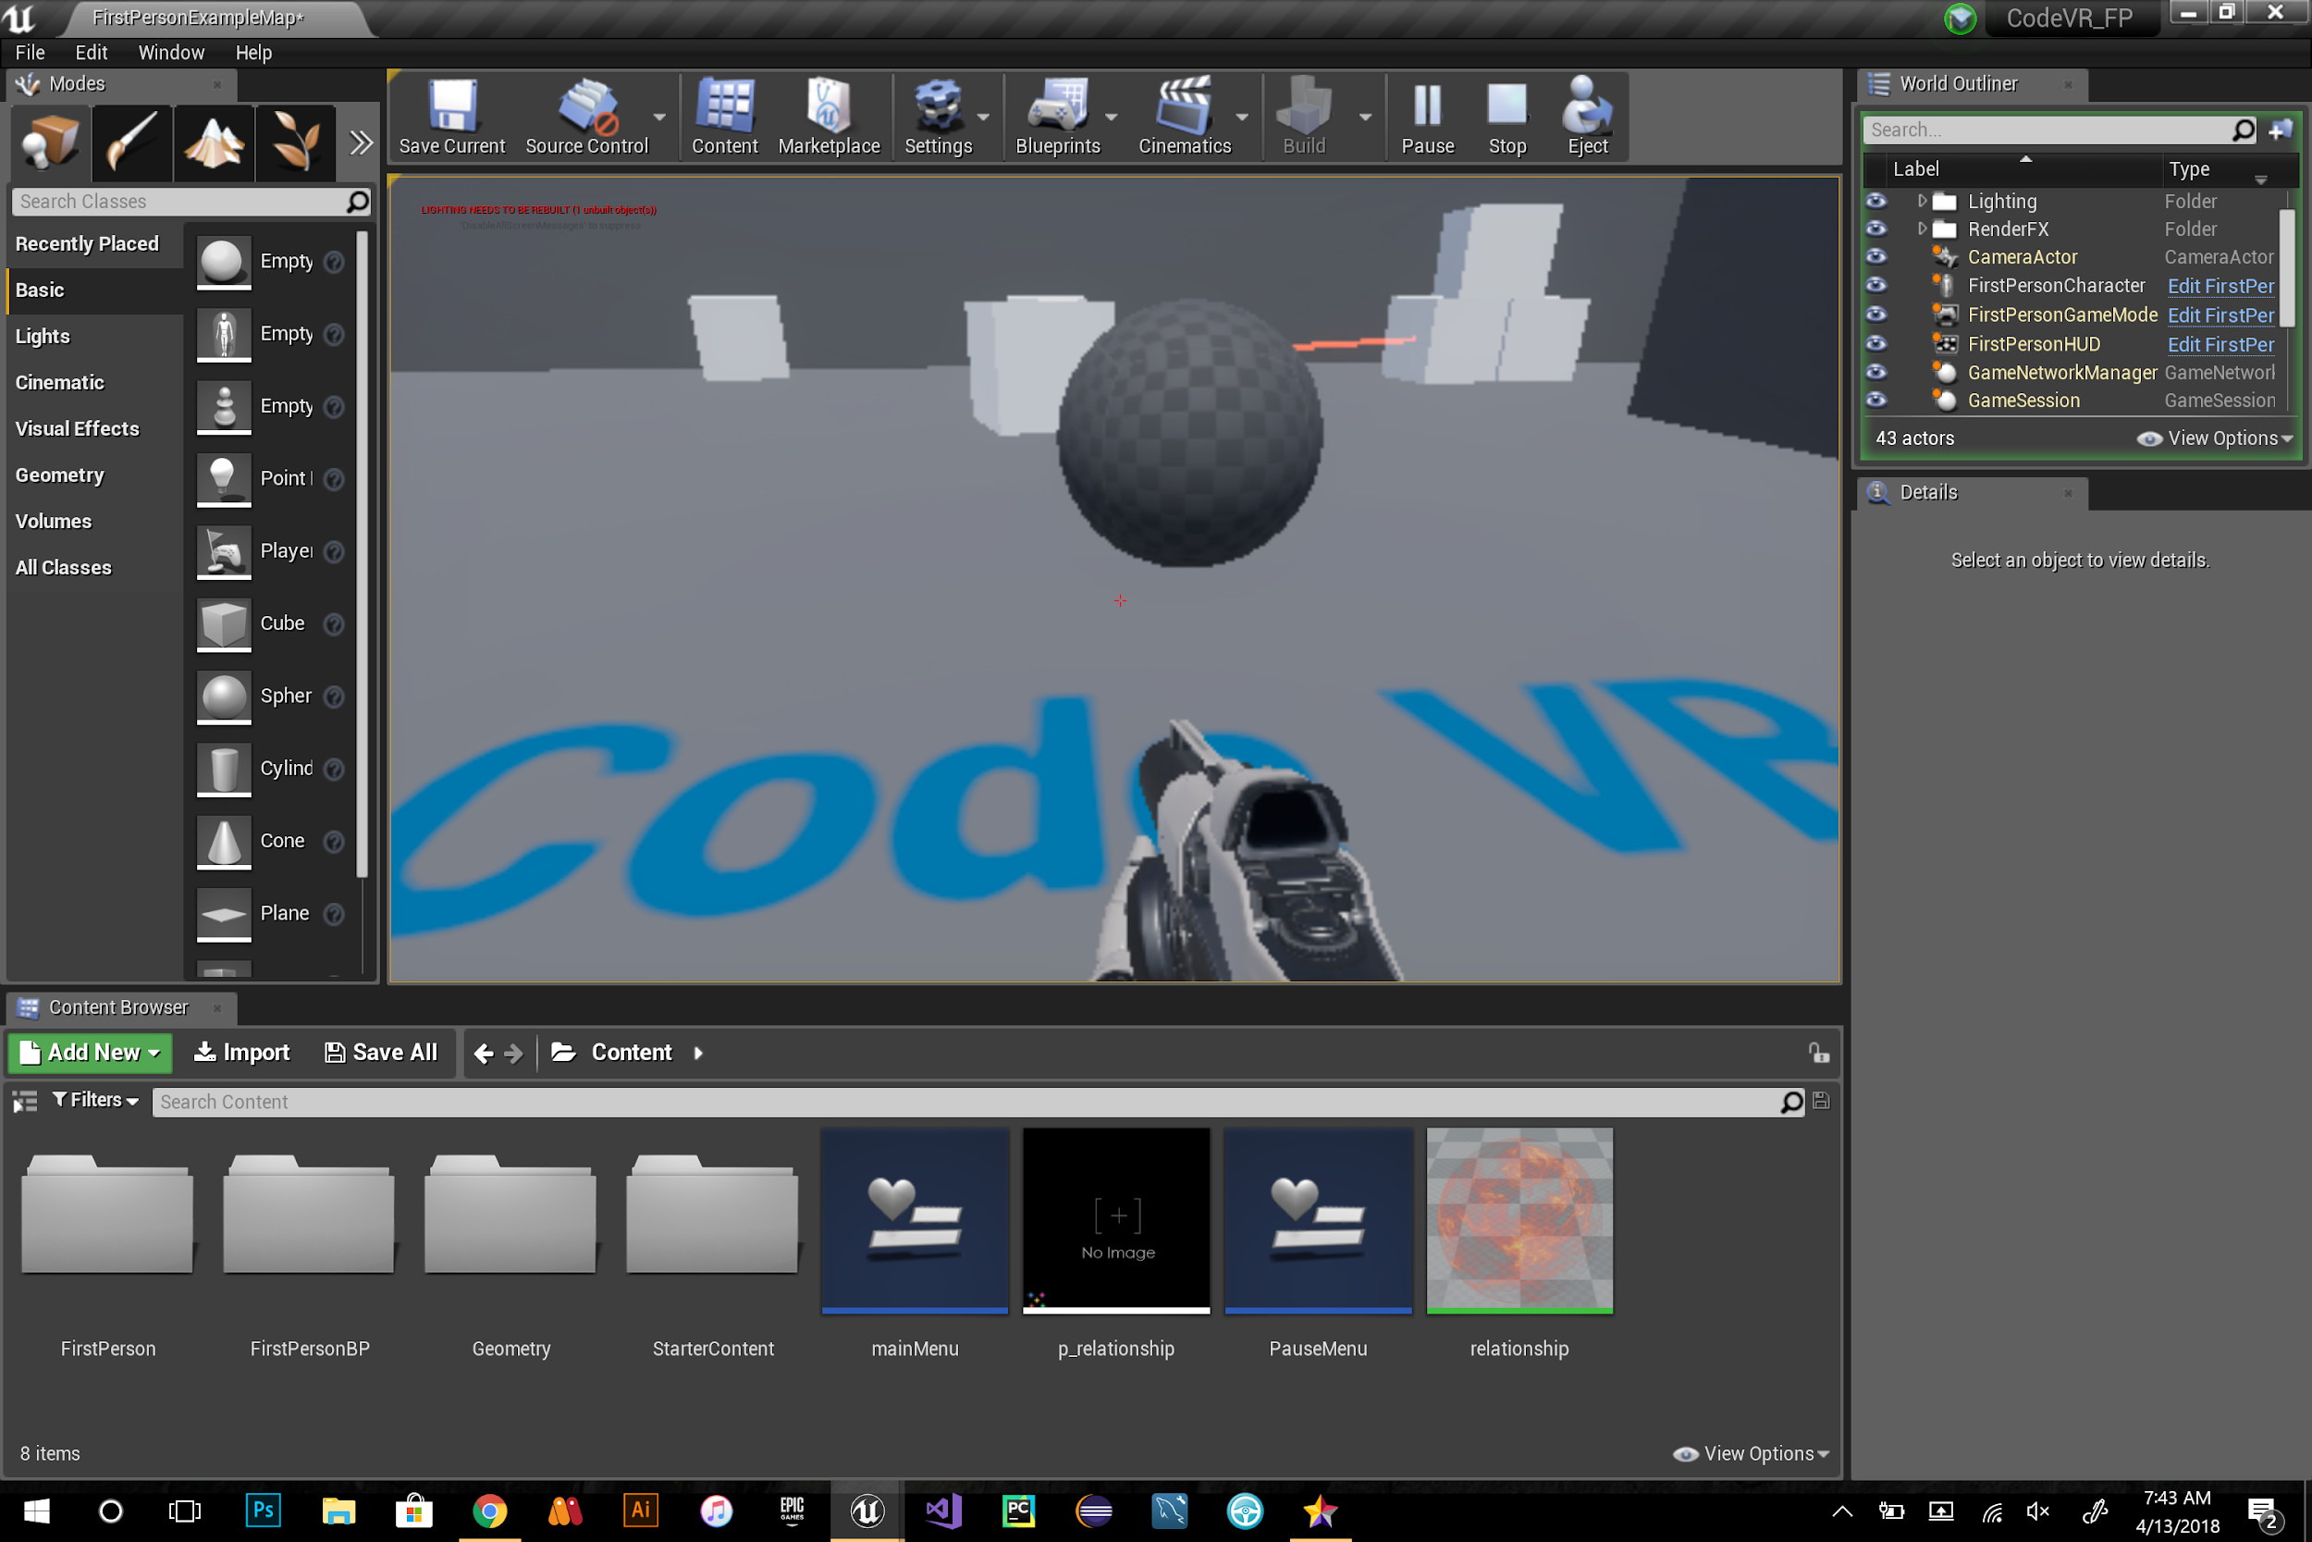
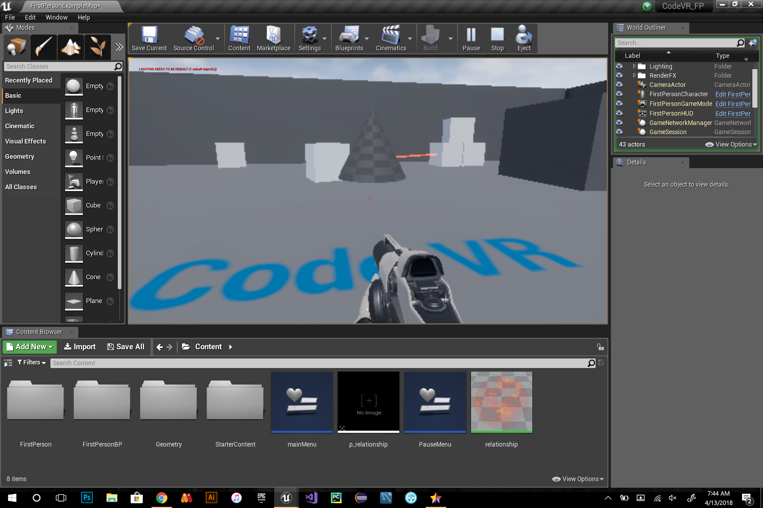
User Story ID #691 3D shape generator functionality
Notes:
20 seconds
The tile of user story
Please present and show the complexity of your work, code, algorithms, and technical challenges and technologies you have used. (you could use screenshot if you want. Visual presentations are better than text presentation) - Go into the details of the most important/significant tasks using bullet lists or visual graphs or state chart diagram - Demo using screenshots or GIF (in another separate page if required)
Sequence Diagram for this user story is optional

Slide 10
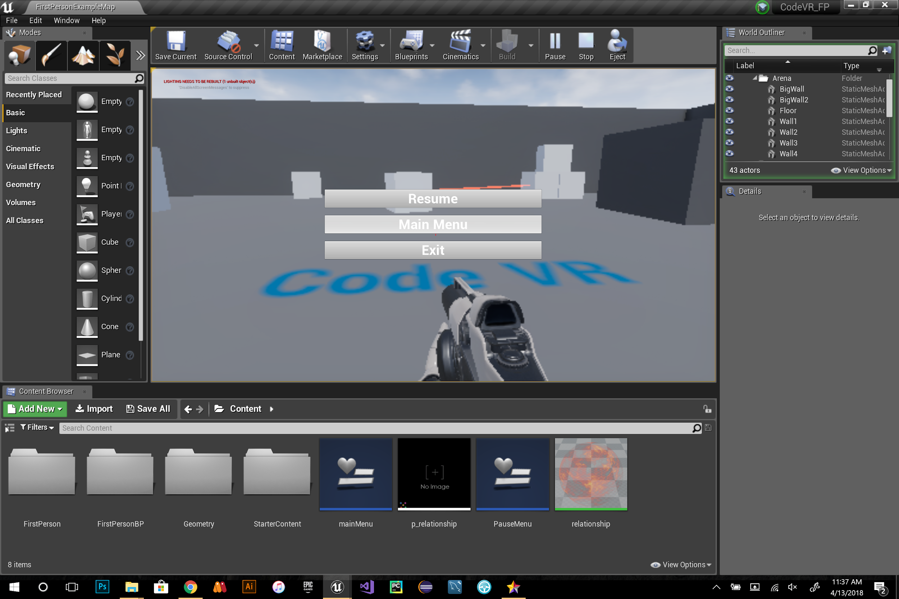
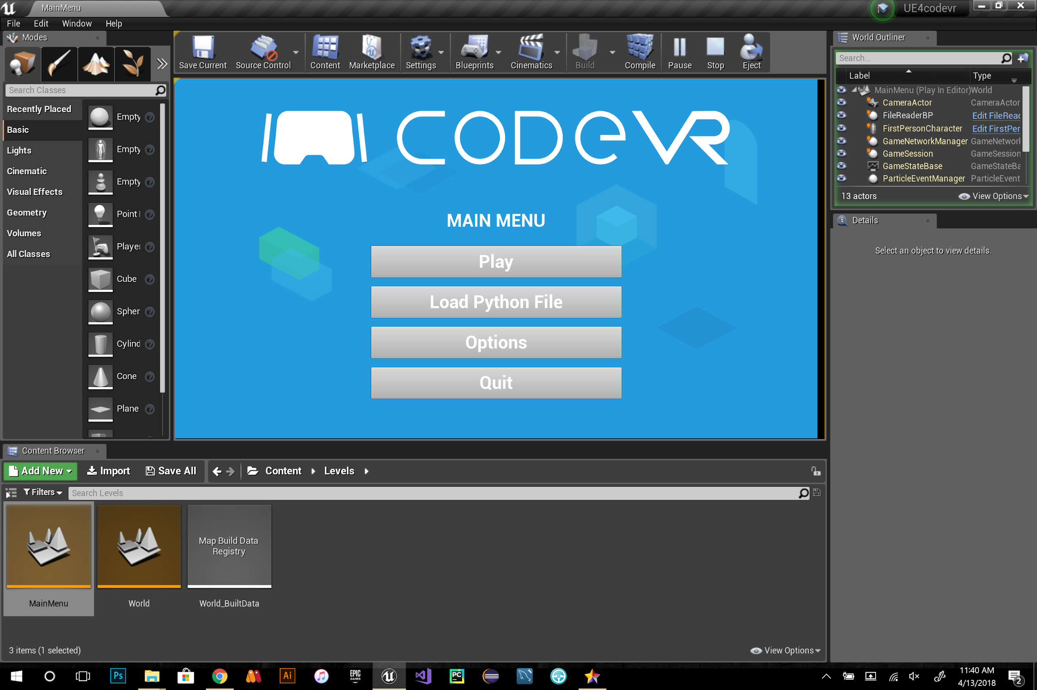
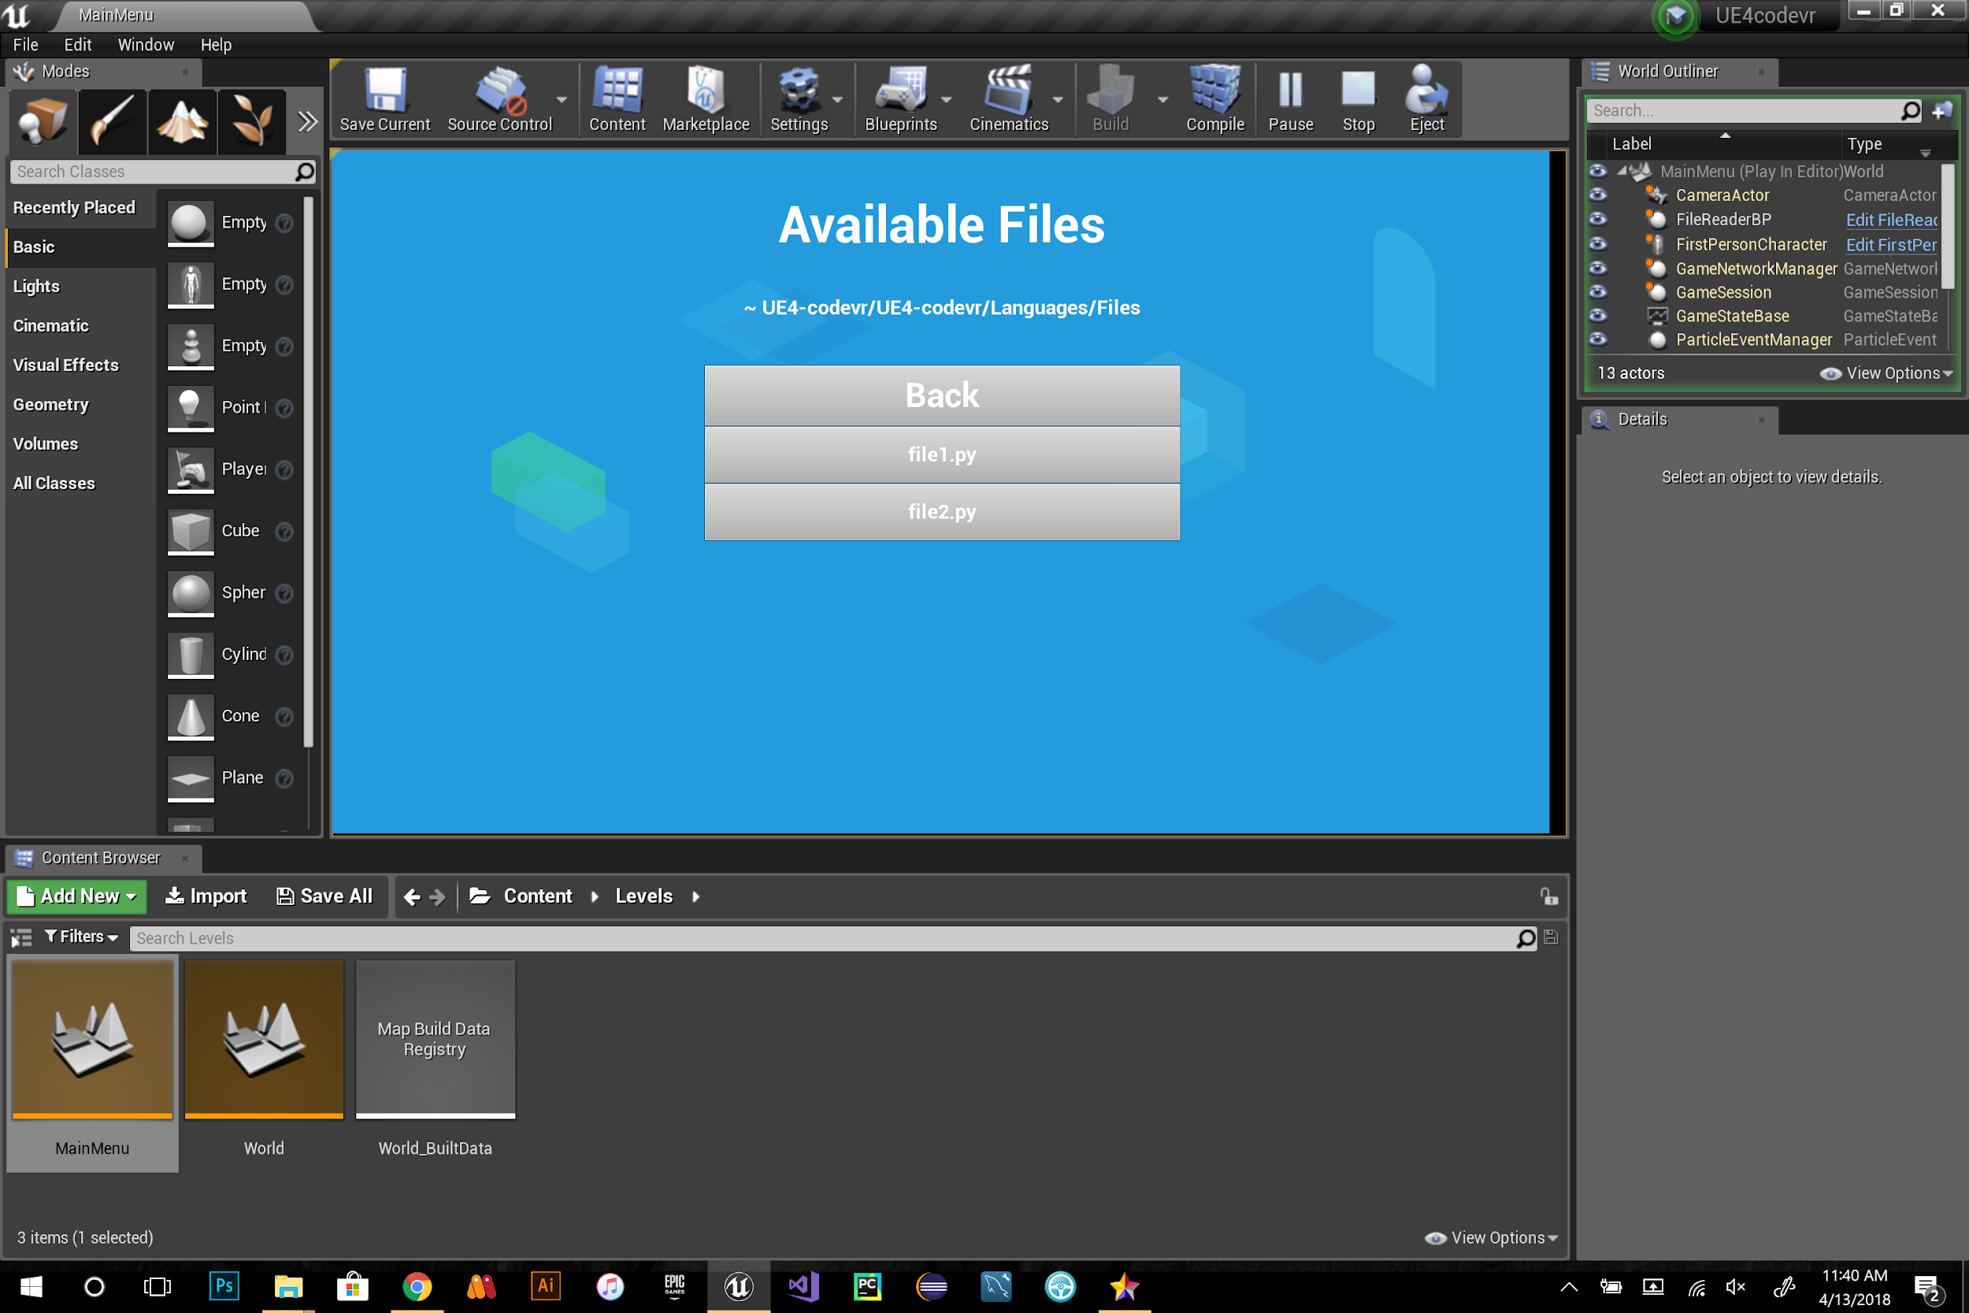
User Story ID #694 Update code-VR Menu
Notes:
20 seconds
The tile of user story
Please present and show the complexity of your work, code, algorithms, and technical challenges and technologies you have used. (you could use screenshot if you want. Visual presentations are better than text presentation) - Go into the details of the most important/significant tasks using bullet lists or visual graphs or state chart diagram - Demo using screenshots or GIF (in another separate page if required)
Sequence Diagram for this user story is optional

Slide 11
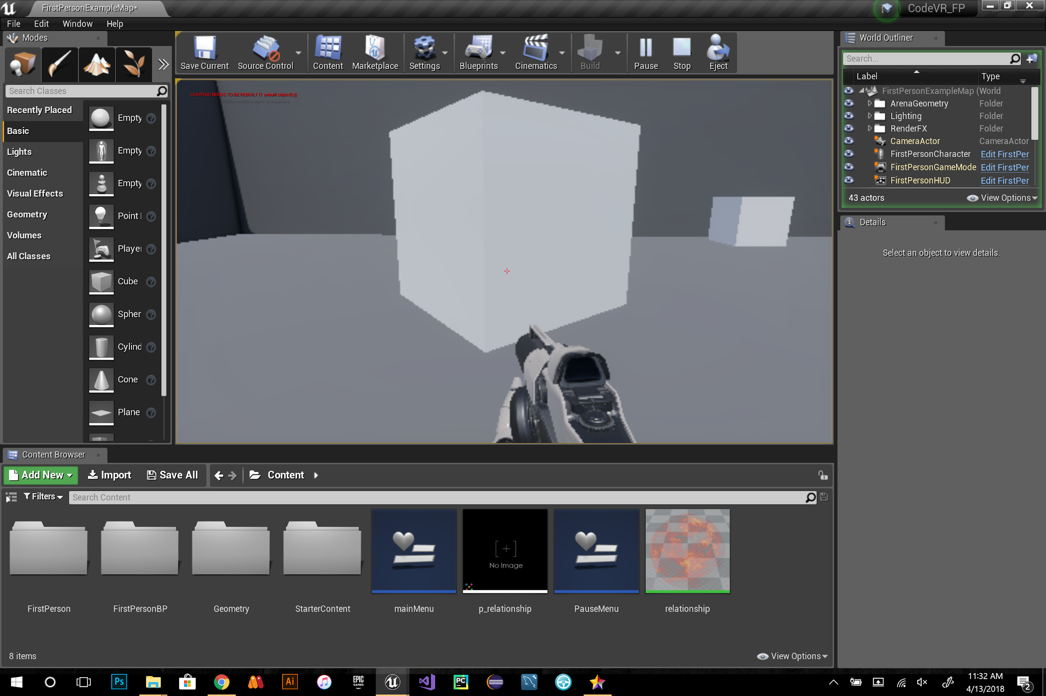
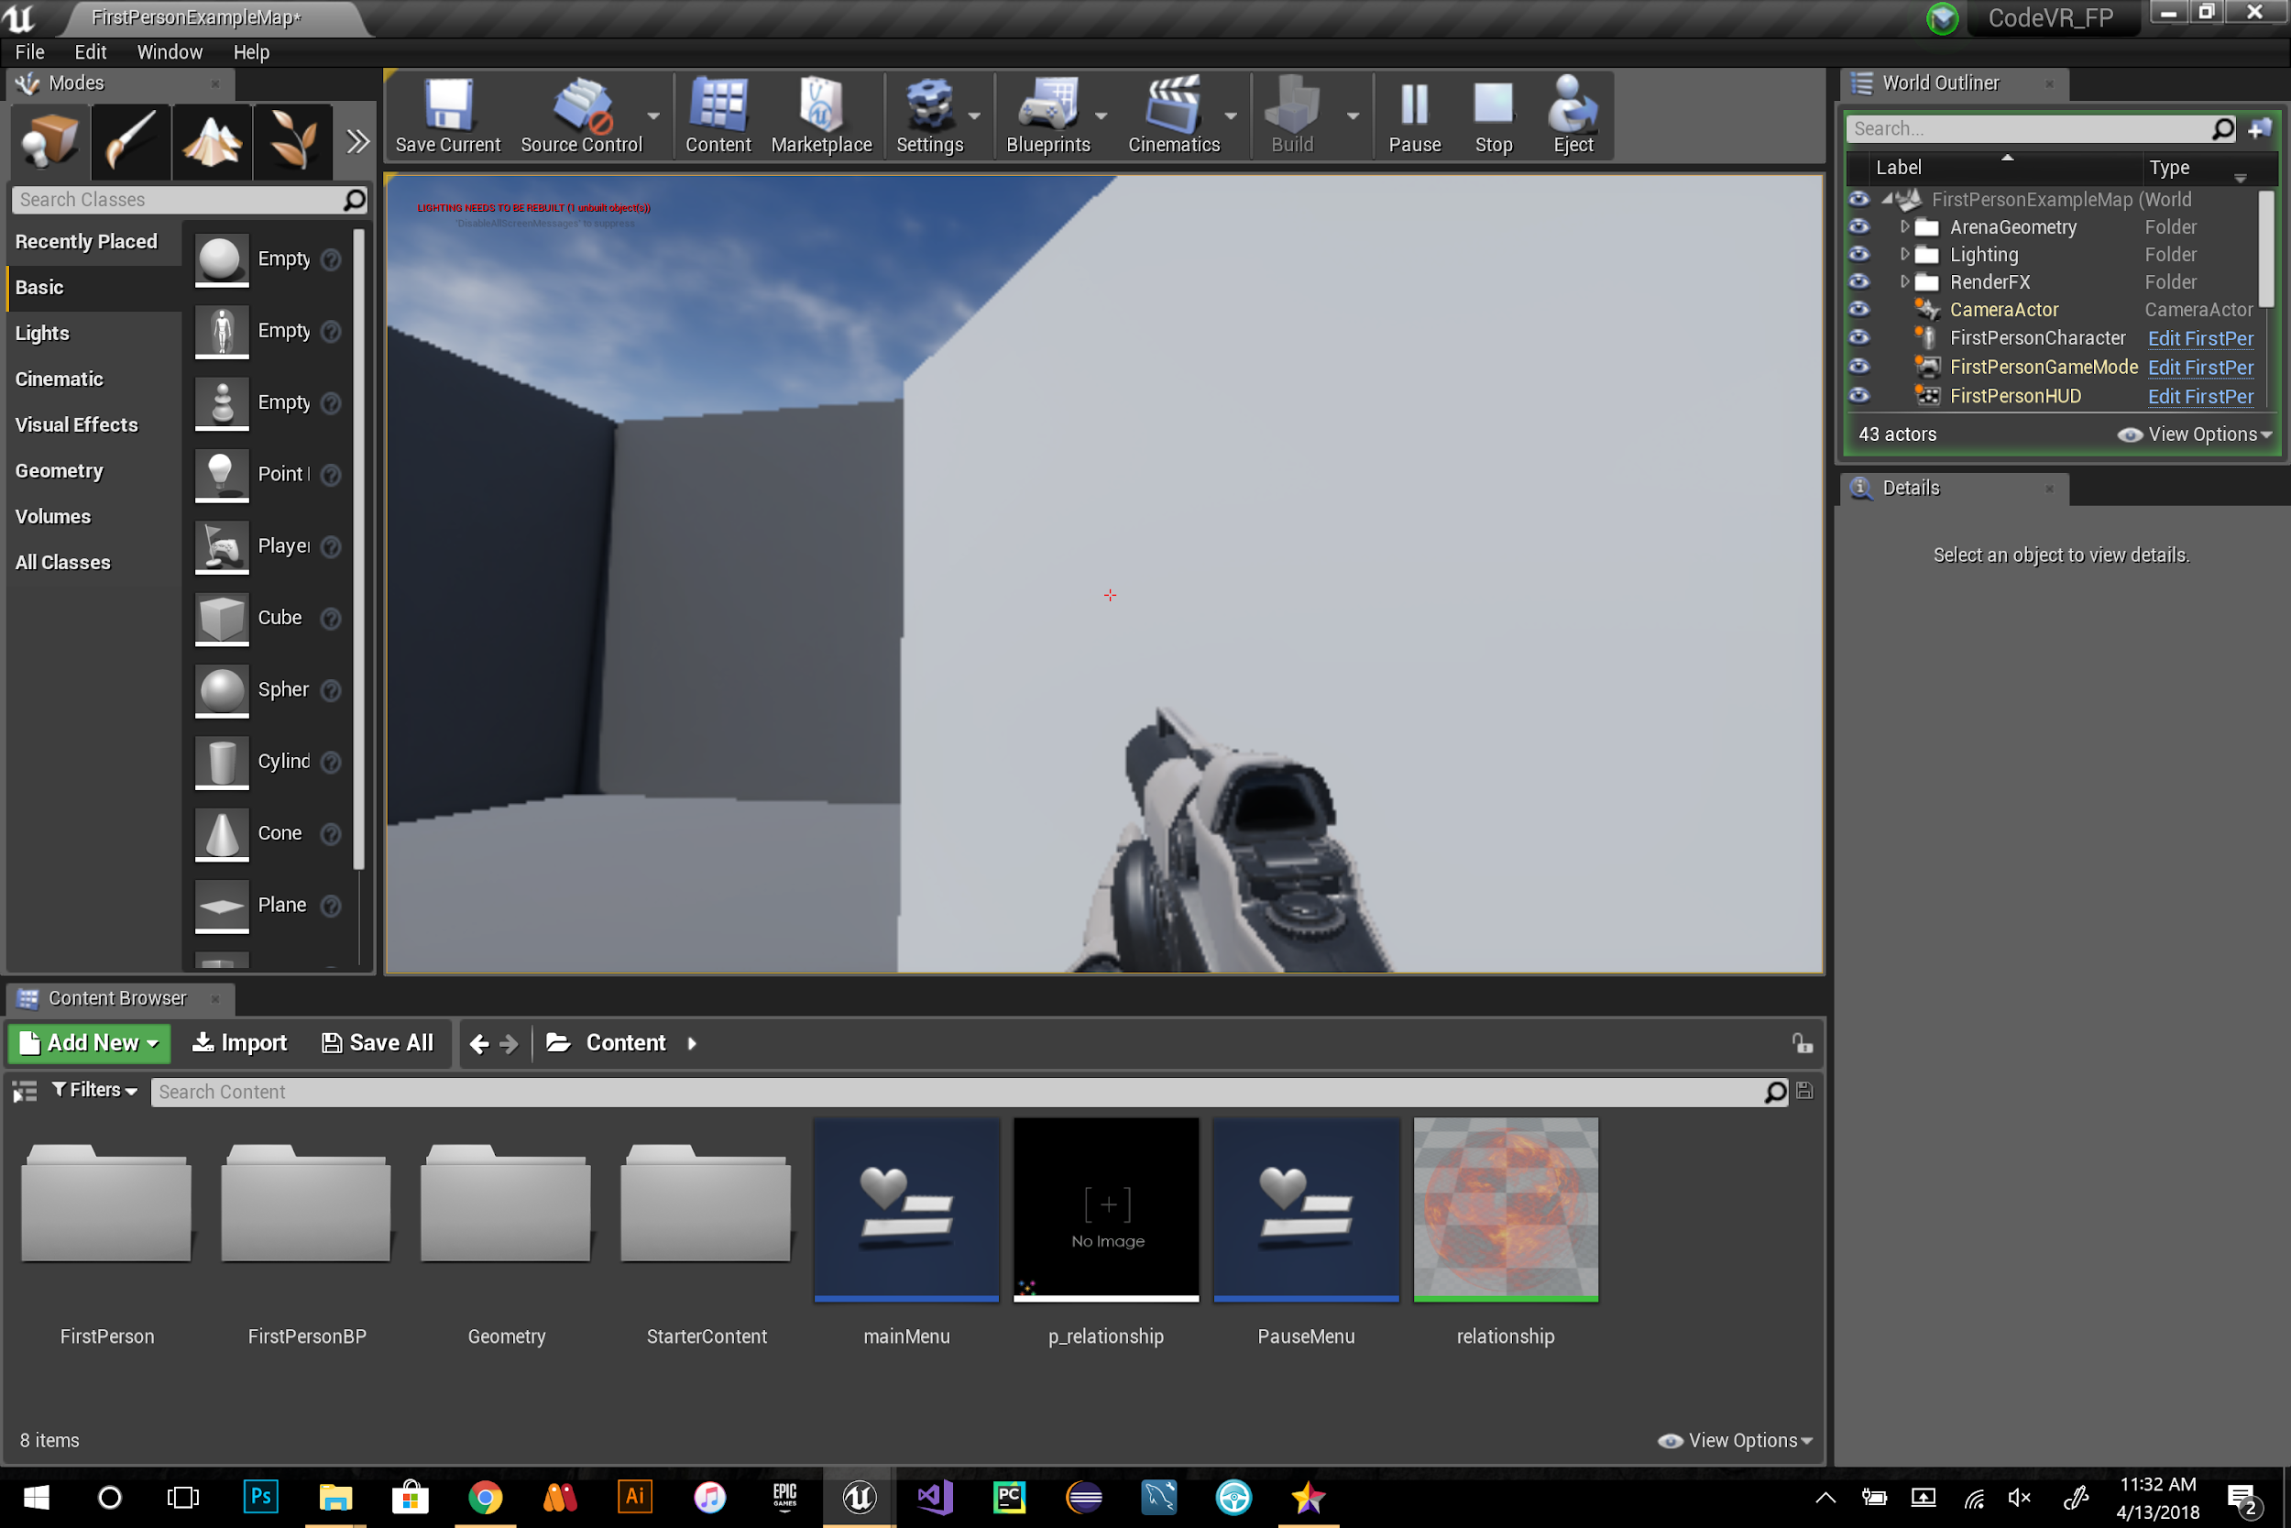
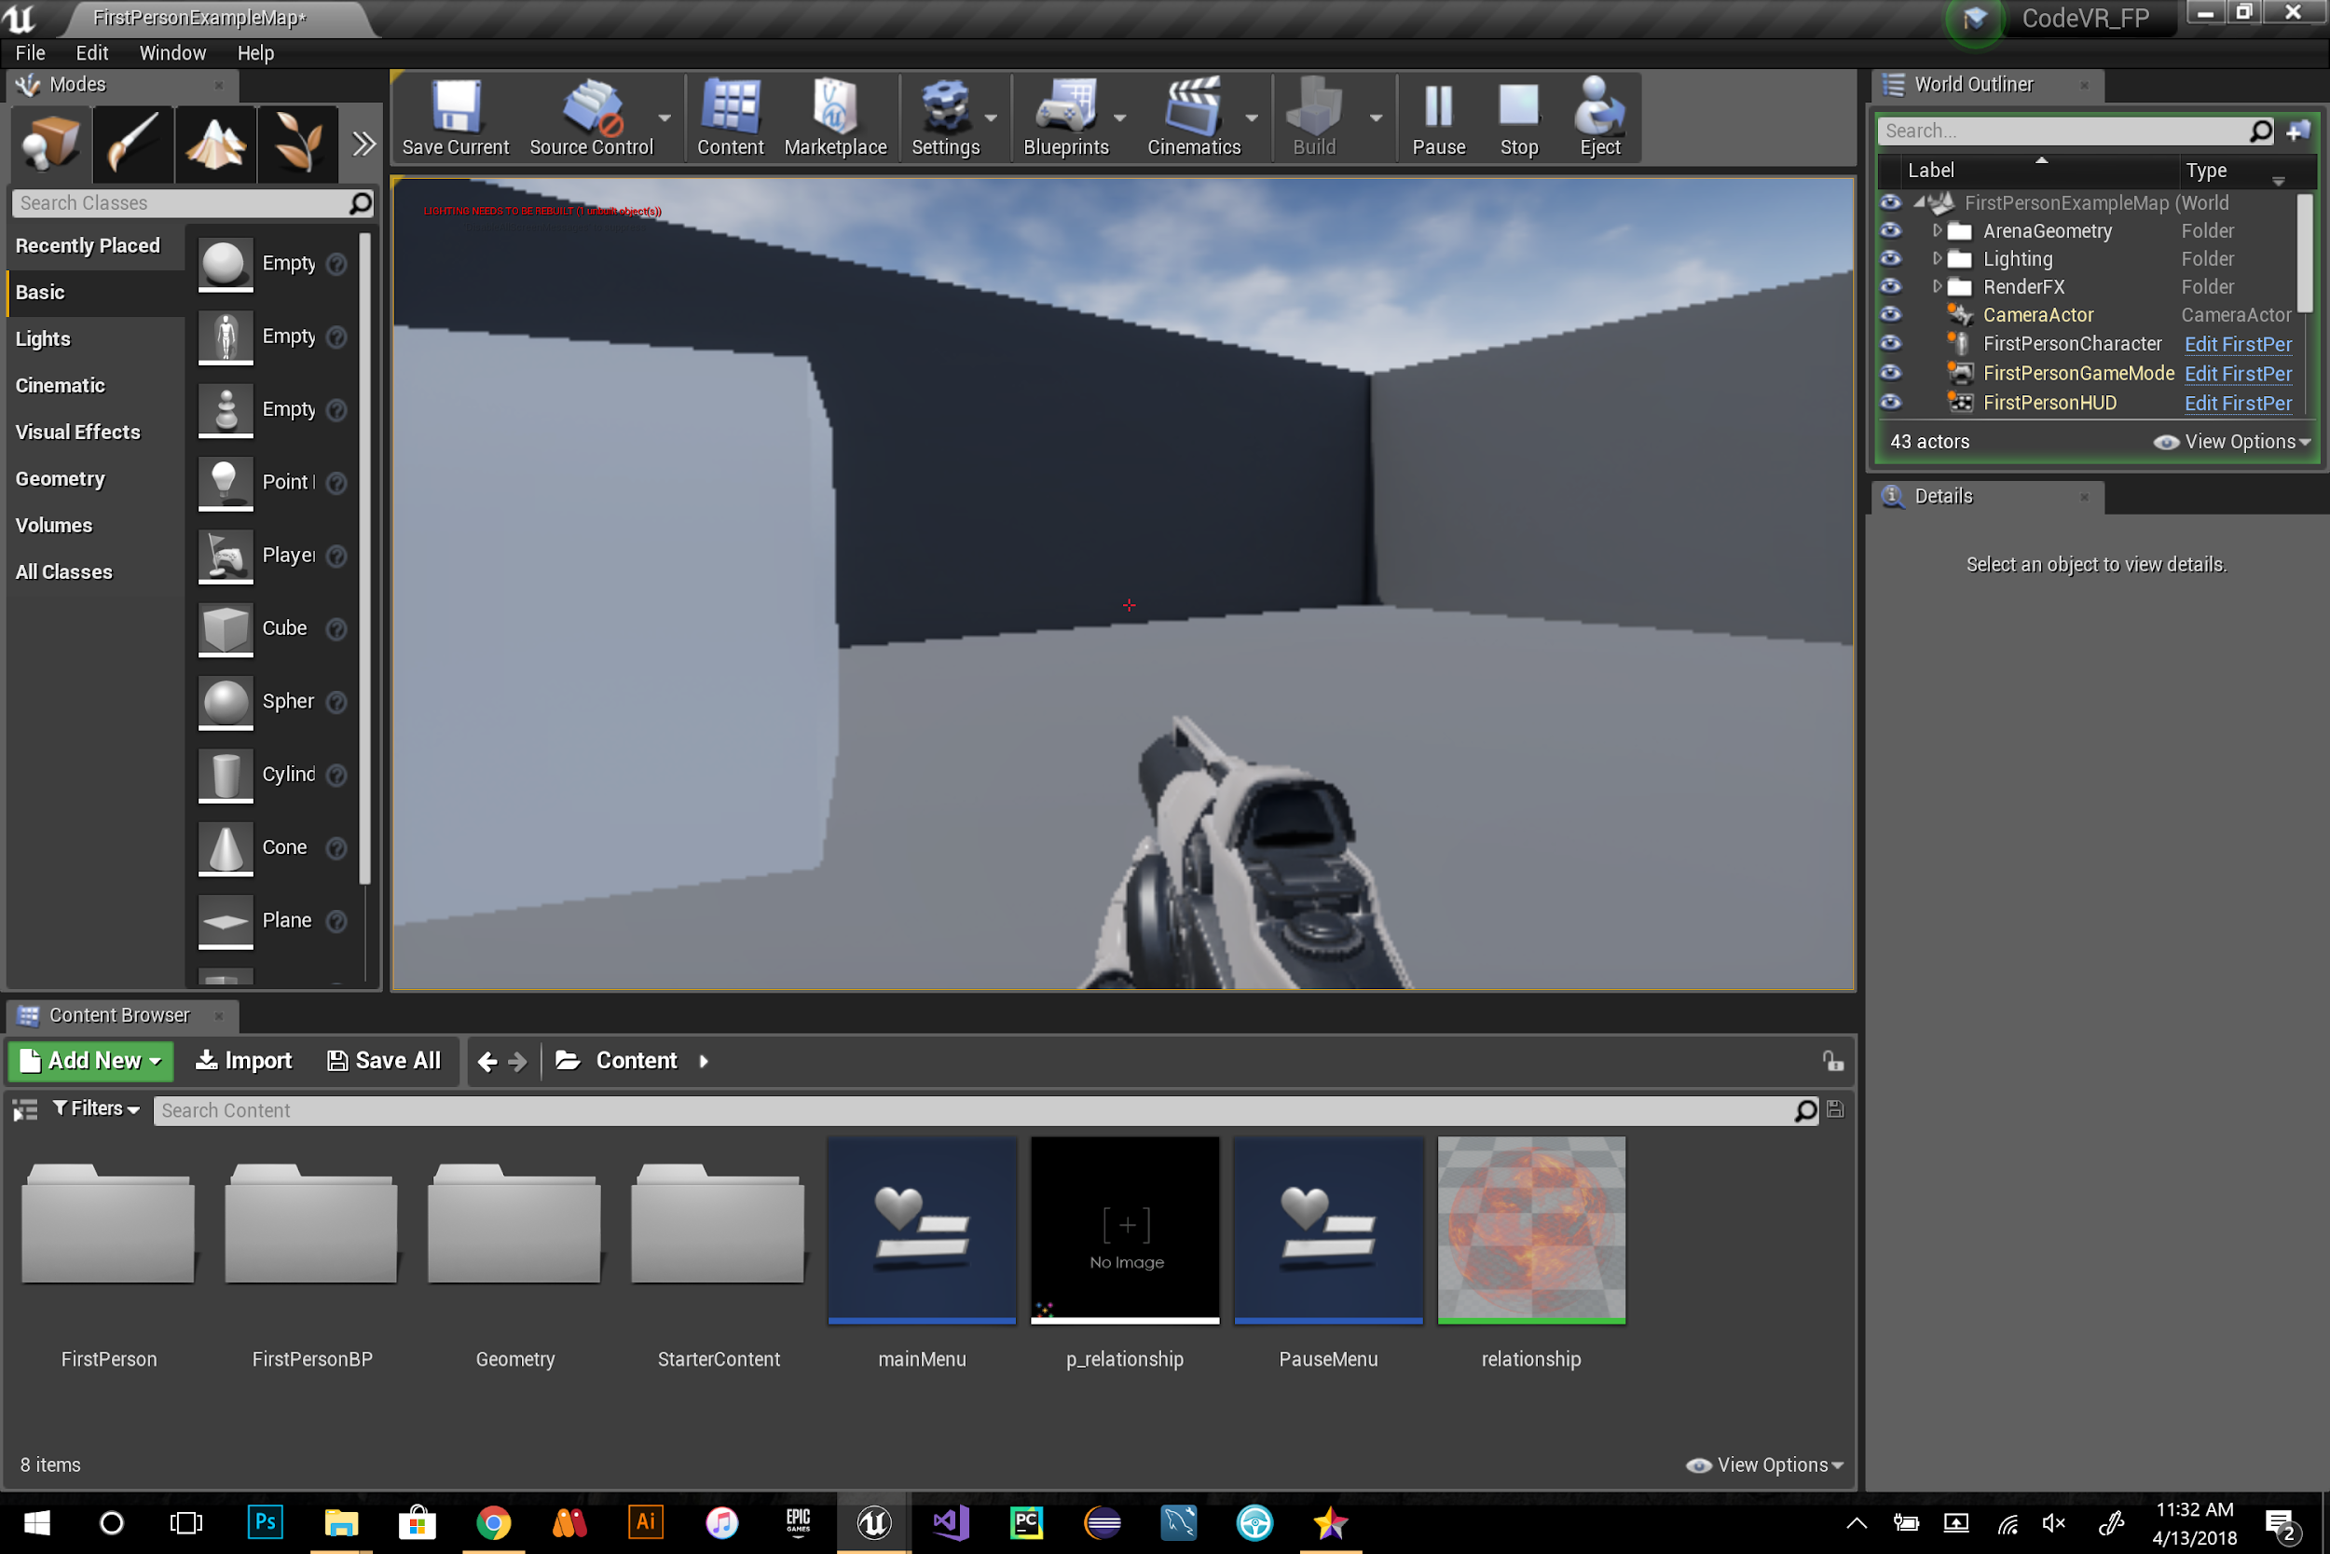
User Story ID #688 Grab and Drop Functionality
Notes:
20 seconds
The tile of user story
Please present and show the complexity of your work, code, algorithms, and technical challenges and technologies you have used. (you could use screenshot if you want. Visual presentations are better than text presentation) - Go into the details of the most important/significant tasks using bullet lists or visual graphs or state chart diagram - Demo using screenshots or GIF (in another separate page if required)
Sequence Diagram for this user story is optional

Slide 12
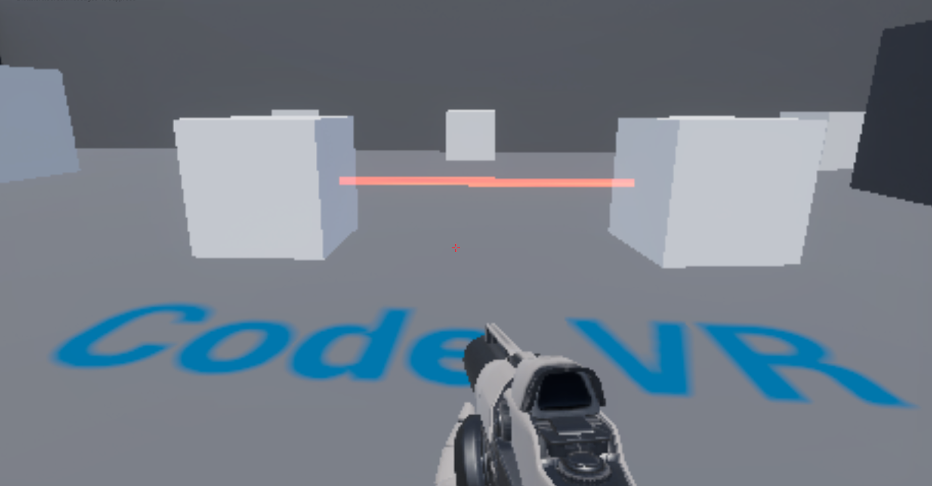
User Story ID #692 Relationship Functionality
Notes:
20 seconds
The tile of user story
Please present and show the complexity of your work, code, algorithms, and technical challenges and technologies you have used. (you could use screenshot if you want. Visual presentations are better than text presentation) - Go into the details of the most important/significant tasks using bullet lists or visual graphs or state chart diagram - Demo using screenshots or GIF (in another separate page if required)
Sequence Diagram for this user story is optional

Slide 13
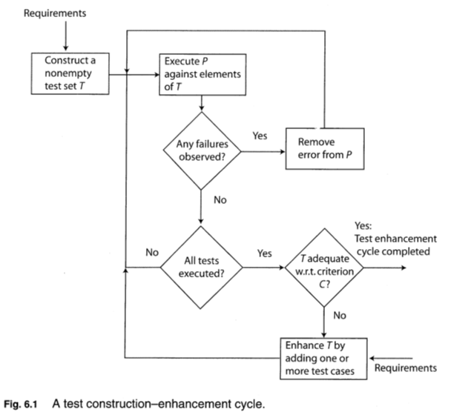
Test Suites and Test Cases
fig5: Test set generation and enhancement
Notes:
10 seconds
A description of verification process and Test Suites and Test Cases for one of the use cases.
1 One sunny day and one rainy day for the implemented use cases (one or more slides).
2 Automated test scripts for the implemented use cases (if any) (one or more slides).

Slide 14






Summary
Using Scrum, Mingle, Github, Google drive, Unreal Engine 4 and C++, I implemented a Set of functions such as: “ a set of new 3D shapes, a grabber, a relationship viewer, a 3D objects generator, pause, and resume”, for a dynamic UX.
contact information
Name : Rolf K. Gilet
email: rgile002@fiu.edu
Questions?
Thank You!
Notes:
10 seconds
Summarize your contribution, mention your effort for Scrum, Mingle, Github, Google Drive Documentation and minutes
Include your contact information
Ask if anyone has any questions for you.
Thank your audience

